Slide 1
PNEUMONIA DETECTION USING CONVOLUTIONAL NEURAL NETWORK
PRESENTED BY:
DINESH KUMAR T
III YEAR,KVCET,AI&DS
NM ID:au421221243005
Gmail id:dineshannalakshmi222003@gmail.com

Slide 2
PROBLEM STATEMENT:
Pneumonia is a potentially life-threatening lung infection that affects millions of people worldwide. Early and accurate diagnosis of pneumonia is crucial for effective treatment and reducing mortality rates. Traditional methods of pneumonia diagnosis rely on the interpretation of chest X-ray images by radiologists, which can be time-consuming, subjective, and prone to human error. The objective of this project is to develop a deep learning-based system using convolutional neural networks (CNNs) to automatically detect and classify pneumonia from chest X-ray images with high accuracy.

Slide 3
Why we use CNN for water quality Analysis?
Convolutional Neural Networks (CNNs) are well-suited for pneumonia detection from chest X-ray images because of their ability to automatically learn and extract relevant features from raw image data, their adeptness at processing grid-like data and capturing local patterns and spatial relationships crucial for identifying pneumonia, their inherent invariance to small shifts and distortions in input data, their scalability and generalization capabilities with sufficient training data, their end-to-end learning approach eliminating extensive preprocessing steps, their potential for interpretability through techniques like saliency maps, and their proven state-of-the-art performance in various medical image analysis tasks, including pneumonia detection.

Slide 4
PROPOSED SYSTEM
Data collection
Import the necessary functions
Data preparation
Splitting of Data
Data processing
Model building
Training the model
Testing the model
Accuracy of the model

Slide 5
SYSTEM APPROACH
SYSTEM REQUIREMENTS:
HARDWARE: Laptop i3 processor with 4gb ram,keyboard,mouse
Software:Anaconda (Jupyter Notebook)

Slide 6
Problem Formulation: The problem can be formulated as a binary image classification task, where given a dataset of chest X-ray images, the goal is to develop a convolutional neural network (CNN) model that can accurately classify each input image as either containing evidence of pneumonia or being a normal, healthy case. The CNN architecture must be designed to effectively capture the relevant visual patterns and features from the X-ray images that discriminate between pneumonia and normal cases. .
Data Exploration:
Dataset collection.
Exploratory data analysis (EDA).
Algorithm Selection and Implementation:
Utilizing Convolutional Neural Networks (CNNs).
Training and validation.
Model evaluation.
Deployment:
Integration into application.
Scalability and reliability.
Continuous improvement.

Slide 7
.
Features Used for Training:
Features used for training include various chest X-ray images , the primary features used are the raw pixel values of the input X-ray images themselves. CNNs are capable of automatically learning relevant features directly from the image data during the training process, without the need for explicit feature engineering or extraction.
Training Hyperparameters Used:
Epochs:200
Batch size:32
Model Evaluation (Accuracy): 92%

Slide 8
.
Data Preprocessing: Handle missing values, scale features, and encode categorical variables.
Input to Model: Provide preprocessed new data as input to the trained CNN model.
Model Prediction: Obtain the model's prediction for the new data.
Interpretation: Interpret the prediction result to determine the pneumonia detection

Slide 9
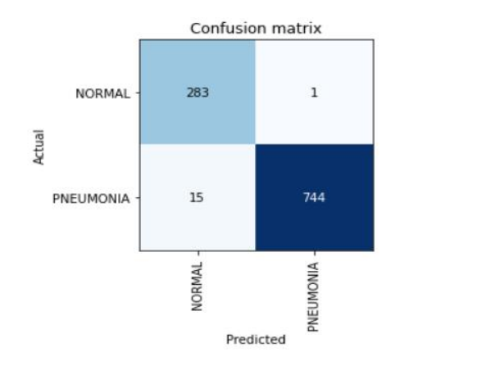
RESULT:
Accuracy :92%

Slide 10
CONCLUSION:
In conclusion, convolutional neural networks (CNNs) have demonstrated promising results for the automated detection of pneumonia from chest X-ray images. By leveraging their ability to automatically learn relevant features directly from raw image data, CNNs can effectively capture the textural patterns, anatomical structures, and visual cues that distinguish pneumonia cases from normal ones.The high accuracy of 92% showcases the potential of CNNs to serve as reliable computer-aided diagnostic tools for pneumonia detection, enabling early diagnosis and timely treatment, which can improve patient outcomes and reduce the burden on healthcare systems. However, the successful implementation of such systems requires addressing several key challenges.

Slide 11
Future works:
Experiment with better CNN designs or try different advanced methods to make the model work even better.
Work together with experts to make easy tools for people to use and understand the results.

Slide 12
REFERENCE:
Dataset:https://www.kaggle.com/datasets/paultimothymooney/chest-xray-pneumonia
Libraries(pandas,numpy etc….)
Github: https://github.com/Dinesh-AT/pneumonia_cnn.git

